Slide 1
Automatic and Scalable Data Selection
Mining High-Quality Data to Speed up Language Model Pertaining
ZHANG Jipeng, 2023.11.18

Slide 2
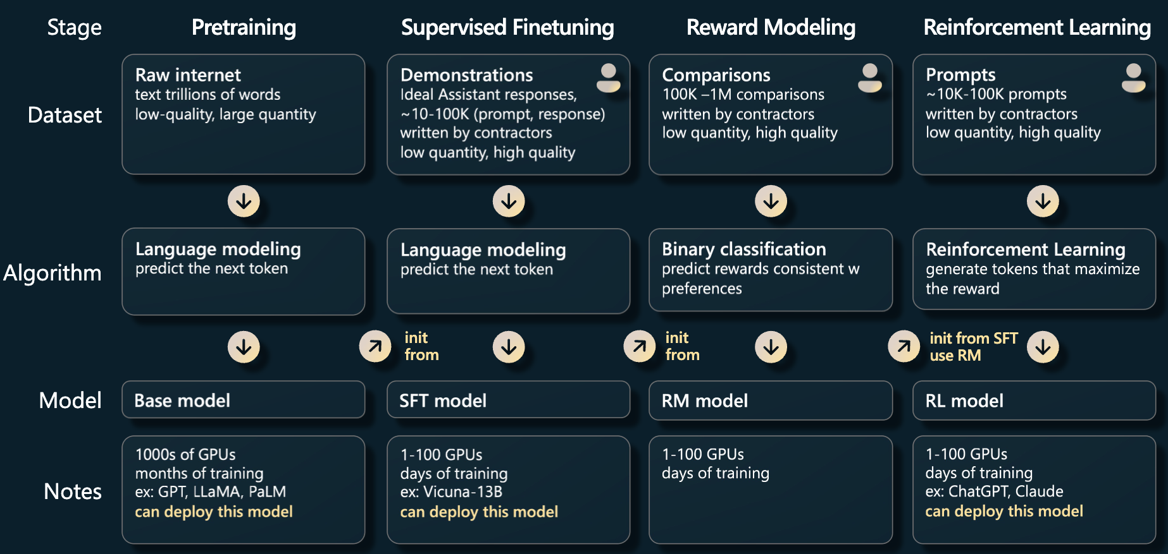
LLM Evolving
[Pre-Training] (Unsupervised Learning)
[Instruction Tuning] (Supervised Fine-tuning)
[Alignment] (RLHF)

Slide 3
Introduction: Why Data Selection

Slide 4
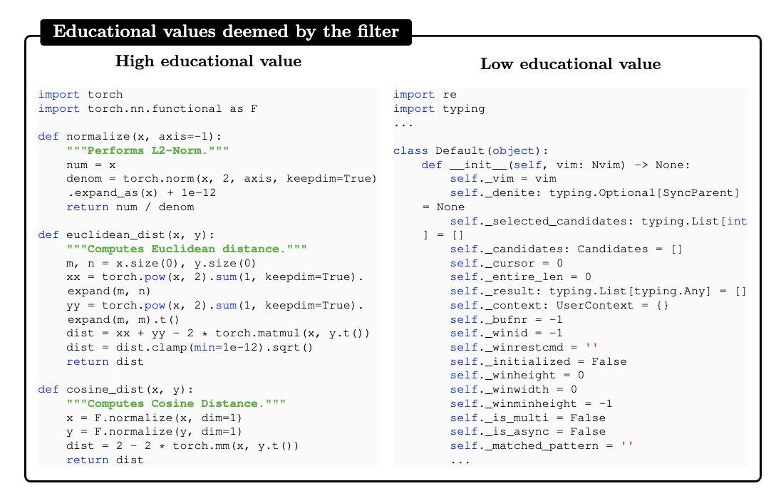
Introduction
The Importance of Quality Data in Large Language Models (LLMs)
Notes:
Let us first introduce The Importance of Quality Data in Large Language Models,
First, a basic argument is that LLM Training requires high quality data, for example, here we have two code snippets. The left one can provide more meaningful knowledge,

Slide 5
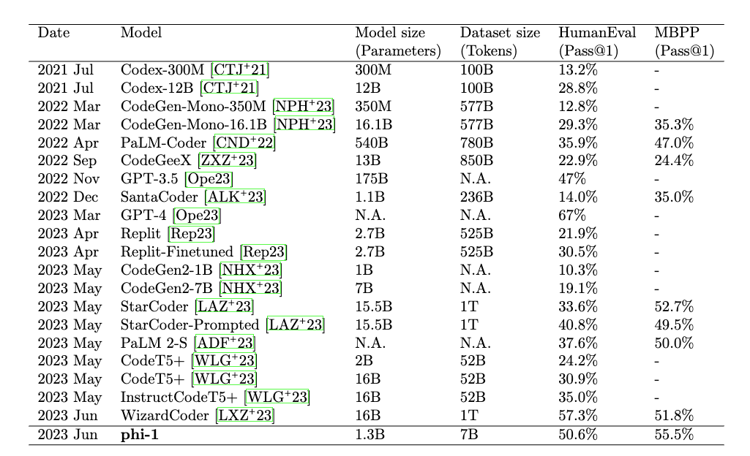
Introduction
The Importance of Quality Data in LLMs
Smaller Model with high quality data can achieve better performance.
Both quantity and quality are important for language model training.
Notes:
Here is a work from Microsoft Research. They compared the relation between data quantity and quality. Based on this table, they argued that the 7 Billion high-quality data generated from GPT-4 can make a smaller size model perform better than larger model trained with noisy data. In conclusion, it is very important for us to get a large amount of high-quality data for language model pertaining.

Slide 6
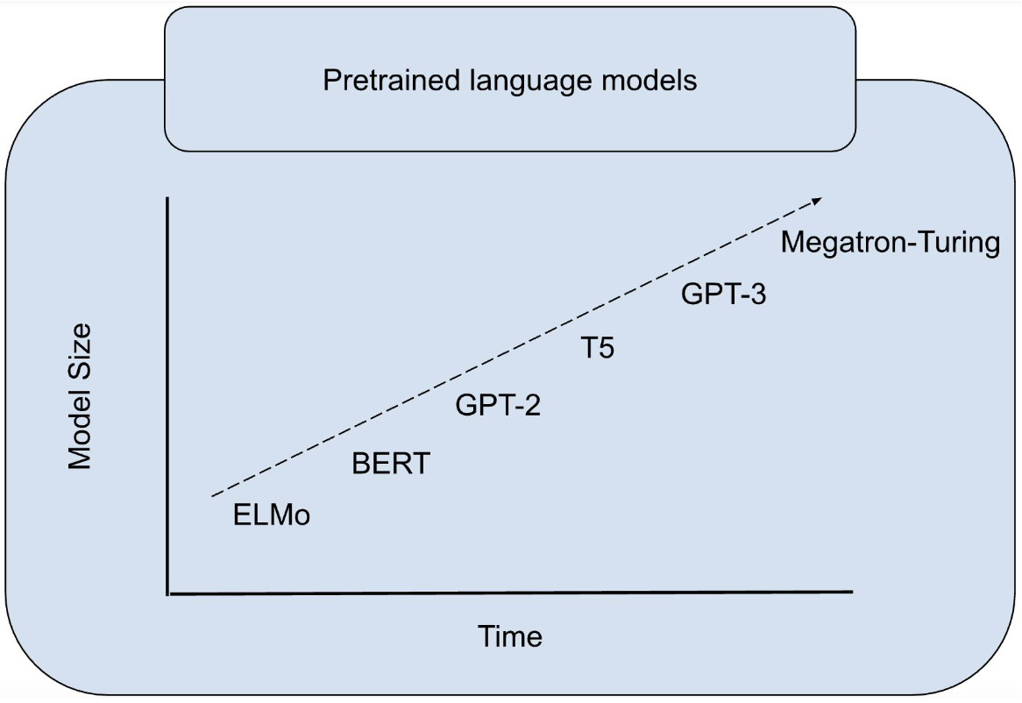
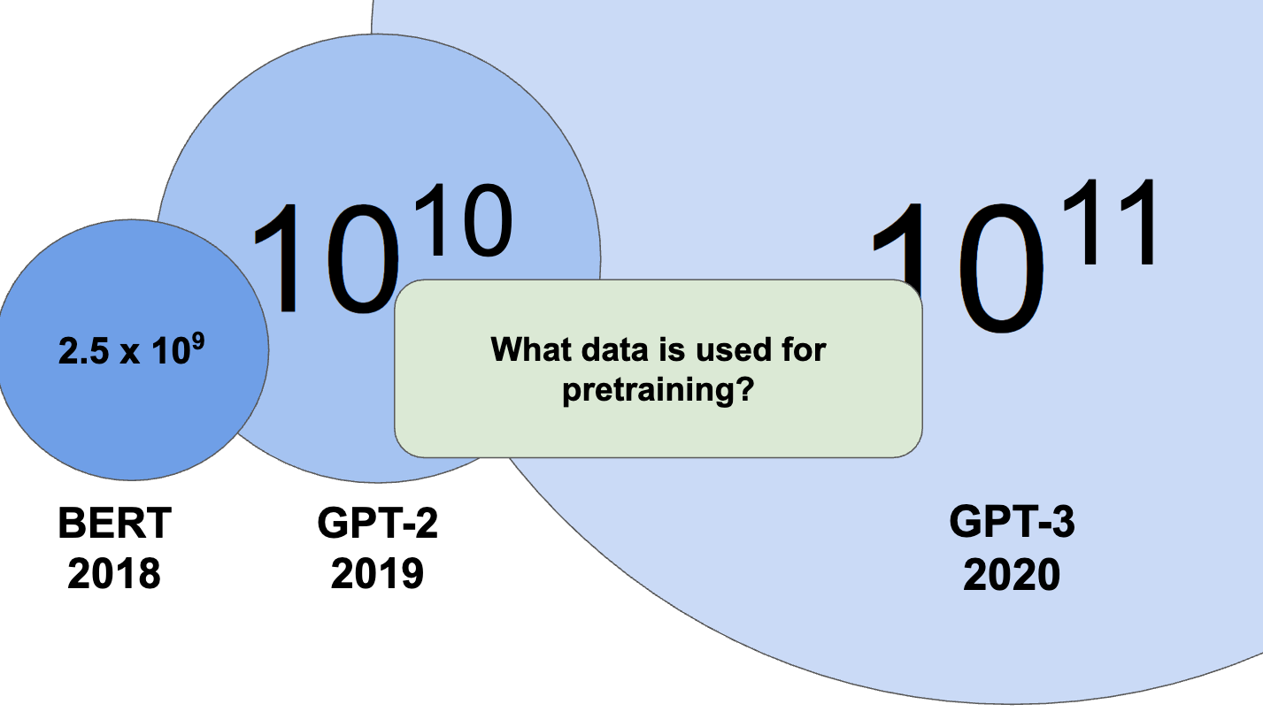
Introduction
The Challenges in Data Selection of Quality Data in LLMs
There are many challenges in handling biased and noisy data, computation scale is the most significant one in LLM Training. We need scalable method.
Notes:
There are many challenges for implementing data selection for Large Language Models’ training data. The computational scalability is the most significant one to handle. Here we can see, with the explosive development of language models, it becomes larger and larger. According to OpenAI’s scaling law, we can find that the high-quality training data should also scales in similar speed. As the right figure shows, we can find that the requirement for data is also increasing in an unreasonable speed. This poses the chanllenge to finish data quality estimation in a given computation budget. In conclusion, we need a scalable data selection method.

Slide 7
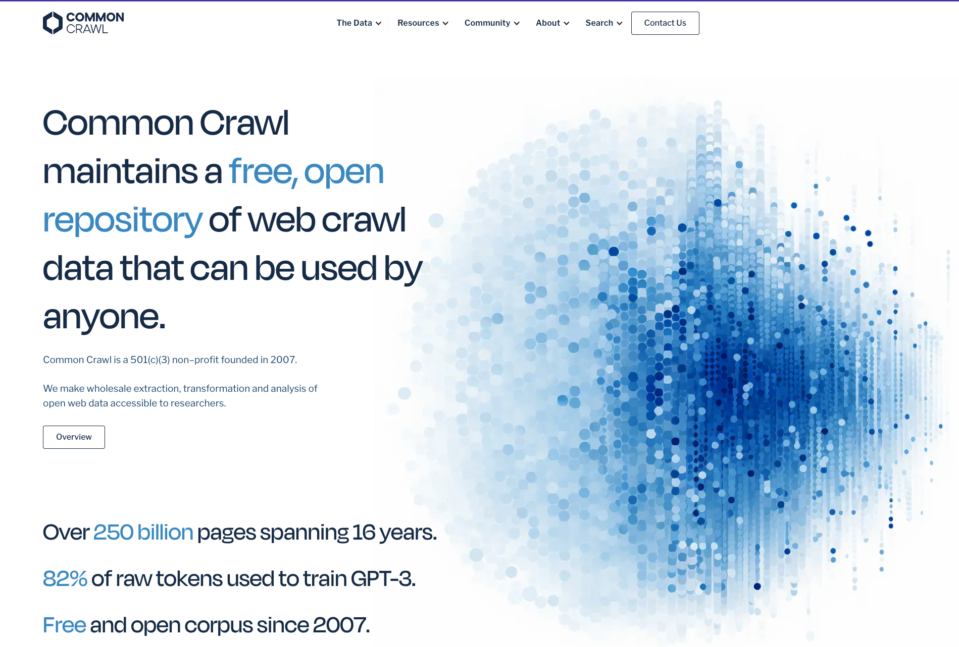
Introduction
The Challenges in Data Selection of Quality Data in LLMs
Another potential challenge is the various sources of training data. We need automatic instead of rule-based heuristics to select data.
Newer datasets are typically built from Common Crawl, a periodic internet-wide snapshot .
Notes:
Also, since Since we need a large amounts of data, all the existing LLM Training data asks for scraping web data from the Internet.
These web data varies a lot in both contents and formats. These web data varies a lot in both contents and formats. It is very time consuming and difficulty to maintain a group of rule-base heuristics to filter all these web texts. Thus, we need a automatic data selection method.

Slide 8
Method: Measuring Data Quality

Slide 9
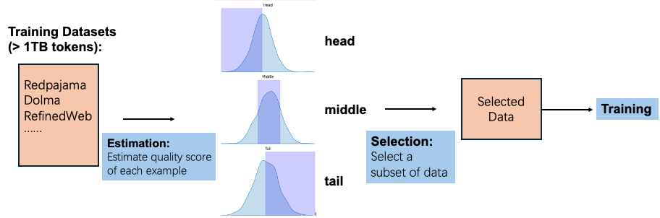
Method
Perplexity-Based Data Quality Estimation
Notes:
In method part, I am going to describe the whole process of ranking and pruning datasets.

Slide 10
Method
Perplexity-Based Data Quality Estimation
Notes:
First, given a training dataset, we will first implement estimation of each sample. In detail, we will compute a quality score for each example with a specific metric. Next, based on the scores of each example, we can get the rank of all these models. Thus, we can find the data with lower scores. We pick these data example and formalize the so called “head” part of the data. Similar, we can pick the middle part and tail part.

Slide 11
Method
Perplexity-Based Data Quality Estimation
Notes:
Next, based on the scores of each example, we can get the rank of all these models. Thus, we can find the data with lower scores. We pick these data example and formalize the so called “head” part of the data. Similar, we can pick the middle part and tail part.

Slide 12
Method
Perplexity-Based Data Quality Estimation
Notes:
In the next step, based on the previous mentioned head, middle, tail splits concepts, we can adjust there portions in the whole sets to get different subset of datasets. In other words, we can select a subset of data based on the previous ranking results.

Slide 13
Method
Perplexity-Based Data Quality Estimation
Notes:
Finally, give the selected data, we need to know its real quality. Unfornately, we can not have a reliable metric to estimate the selection results without training. The only choice is to really use the selected data to train a model. If the model has better performance, we argue the correspond data is better.

Slide 14
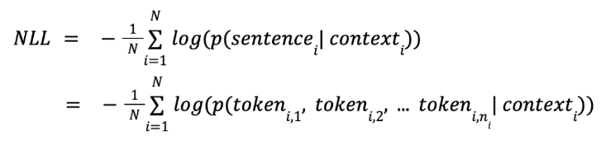
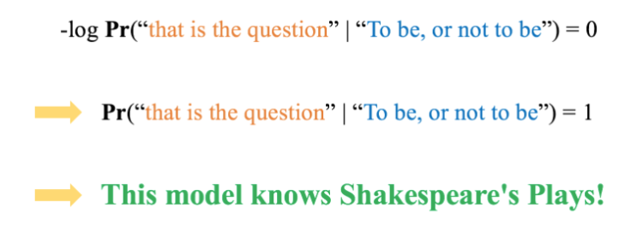
Method
Perplexity-Based Data Quality Estimation
Negative Log Likelihood (NLL) is used for training LLM.
Notes:
In order to implement the data estimation. We used a basic metric called PPL. Here is its computation details. Before introducing PPL, let me first introduce NLL. This NLL is widely used in language model tracing and have been proven to be the existing best choice for training. In detail, NLL corresponds to the LLM model’s prediction probability over a word or phrase given their contexts. If the dataset set itself indicates a certain type of LLM ability, such as multi-round conversation, instruction following, math problem solving, role-playing, then NLL on those datasets can provide quantitative metrics to reflect those abilities. The key idea behind NLL, is that generation ability is positively correlated with prediction ability.

Slide 15

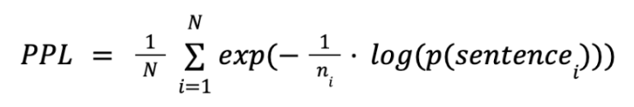

Method
Perplexity-Based Data Quality Estimation
Negative Log Likelihood (NLL) is used for training LLM.
A commonly used evaluation metric in NLP is Perplexity (PPL).
These probabilties comes from models like GPT-2-XL, GPT-Neo, Llama-7b, Llama-13b
Notes:
Nevertheless, in order to balance the impact of sentence length, previous researchers introduce PPL metric. Compared with NLL, this metrics depends on the lengths of the tokenized sequences by normalizing with sentence lengths. All these probabilities are output from a specific large language models. The reason is, we argue a well trained large language models can already provide great estimation of datas.

Slide 16
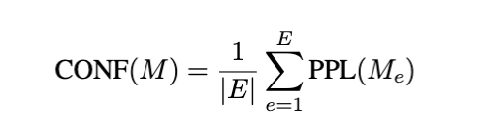
Method
Observing Model Behavior to Select Data
Confidence as the mean of model perplexity across steps’ checkpoints
Notes:
Besides PPL, we argue to use training dynamics to estimate the data quality. It is a by-product of training and can dynamically reflect the model’s quality. In detail, for each data example, we compute the change of PPL across different epochs or steps of training. For training dynamics, it is first introduced in classification style models and datasets. Here, we adapt it to our text-generation scenario with perplexity. We define confidence as the mean of model perplexity across checkpoints in different steps.

Slide 17
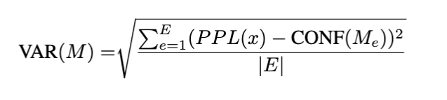
Method: Training Dynamics
Observing Model Behavior to Select Data
Confidence as the mean of model perplexity across steps’ checkpoints
Variability as the standard deviation of model perplexity across checkpoints
With a model called Baichuan2-7b, we can access its intermediate checkpoints to compute its training dynamics.
Notes:
We define variability as the standard deviation of model perplexity across checkpoints in different steps.

Slide 18
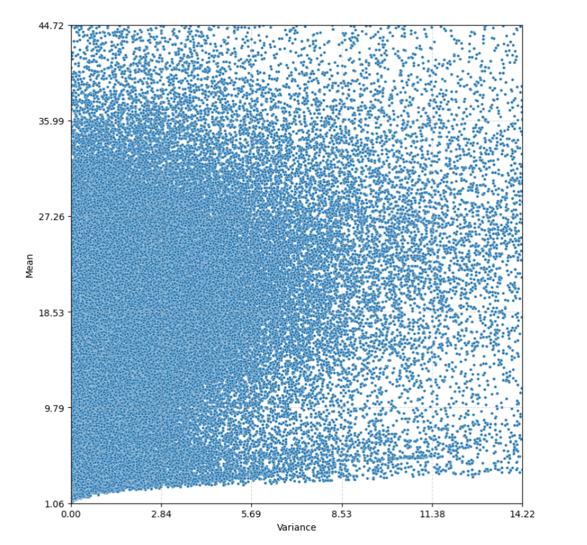


Method
Notes:
Here is a visualization of the training examples using confidence and variability. We can make use of Variability or confidence to make different estimation metrics.

Slide 19
Experiment: Implementation

Slide 20
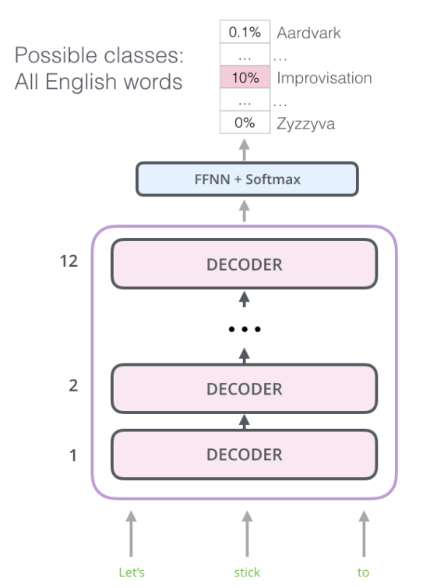
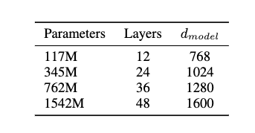
Experiment
Proxy Training Model GPT2
Model:
GPT-2: trained from datasets is collected from outbound links from Reddit (8 million docs, 40 GB)
Training Dataset
a random sample of the Jan 2022 snapshot of CommonCrawl. (3.3 billion tokens, 9GB)
Notes:
Here, in order to reduce the training time, we choose to do continues training from GPT2’s base and large model. They have about 100M and 700M parameters. GPT2 is a typical transformer-based decoder-only language model. It’s architecture is consistent with all the recent popular GPT-style models and is very suitable for research verification.

Slide 21
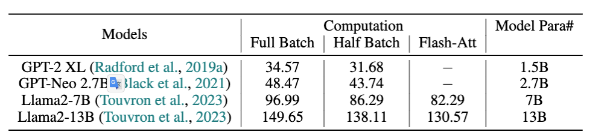
Experiment
Efficiency in Data Processing
How many hours required to compute PPL for 1 Bilion token text examples (3GB)
We tried several acceleration tricks. Reduce computation batch size and use flash attention.
Notes:
Since computing PPL for billions of tokens text datasets is extremely time-consuming. We first benchmark the time-cost for compute PPL for 1 Bilion token text examples (like about 3GB text). We can find that as scoring model scales, the time increases a lot. We made some initial exploration for accelerating computation. Half batch means using half of the maximum batch size a A100-40G GPU can hold. Flash attention is an optimized version of transformer computation.

Slide 22
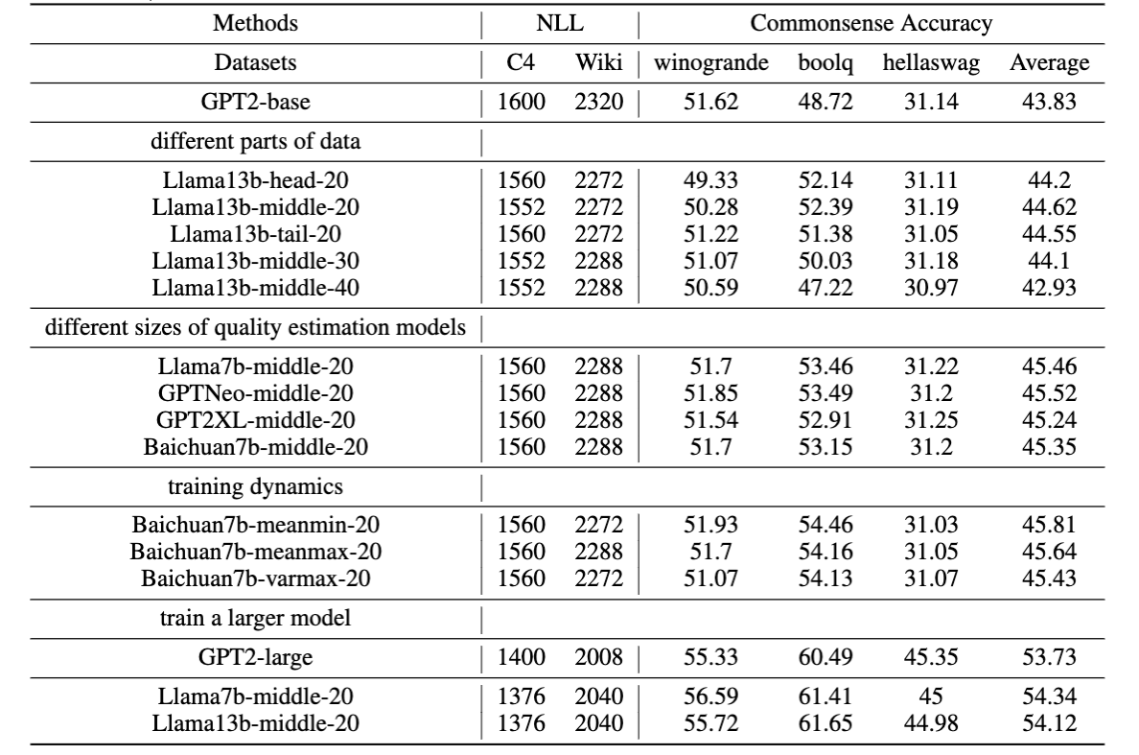
Experiment
Evaluating Model Performance
NLL can not well evaluate the performance difference.

Slide 23
Experiment
Evaluating Model Performance
Middle part give the best performance.

Slide 24
Experiment
Evaluating Model Performance
Its not larger model gives better estimation.

Slide 25
Experiment
Evaluating Model Performance
Training dynamics can give better estimations.

Slide 26
Conclusion: Limitations and Takeaways

Slide 27
Limitations
Recognizing Constraints and Future Research
Our research is still limited in size and need more time to explore the details.
We need to train a larger model with more data examples.

Slide 28
Conclusion
Summarizing Key Takeaways
Estimating data quality with model based metrics is time consuming.
Training dynamics can provide a better estimation for data quality.
Selecting data in the middle can boost model performance and stabilize training by addressing data complexity.

